Slide 1
Functions in Python
User Defined Functions

Slide 2
Function
A function is a block of organized, reusable code that is used to perform a single, related action.
Functions provide better modularity for your application and a high degree of code reusing.

Slide 3
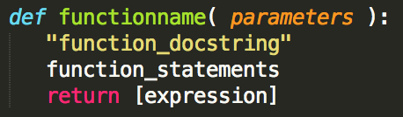
Function
Defining a Function
•The code block within every function starts with a colon (:) and is indented.
•The statement return [expression] exits a function, optionally passing back an expression to the caller.
A return statement with no arguments is the same as return None.

Slide 4

Function
Defining a Function
•Function blocks begin with the keyword def followed by the function name and parentheses ( ( )).
•Any input parameters or arguments should be placed within these parentheses. You can also define parameters inside these parentheses.
•The first statement of a function can be an optional statement -the documentation string of the function or docstring.

Slide 5
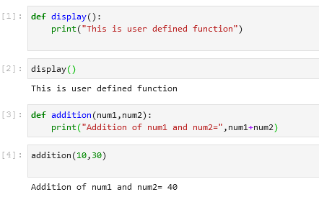
User Defined Functions
User defined function without parameters
User defined function with Parameters

Slide 6
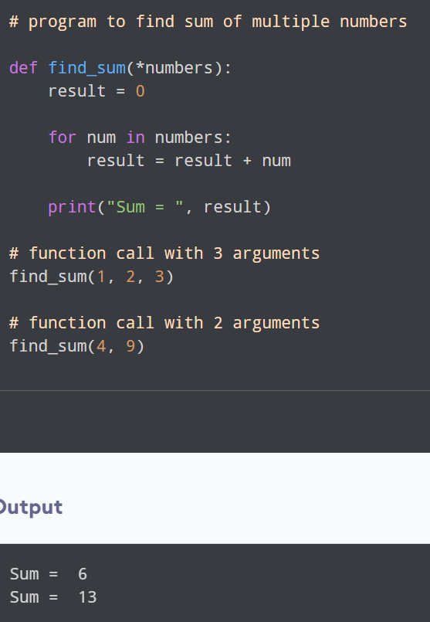
Python Function With Arbitrary Arguments
Sometimes, we do not know in advance the number of arguments that will be passed into a function. To handle this kind of situation, we can use arbitrary arguments in Python.
Arbitrary arguments allow us to pass a varying number of values during a function call.
We use an asterisk (*) before the parameter name to denote this kind of argument.

Slide 7
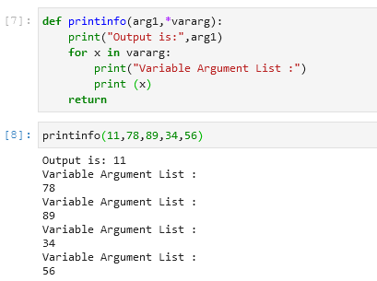
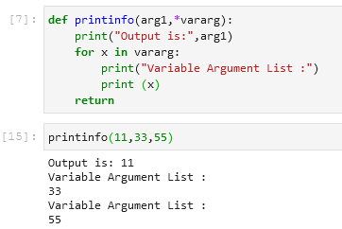
User Defined Functions
For variable length arguments
For unspecified no of arguments, star is used with the variable name

Slide 8
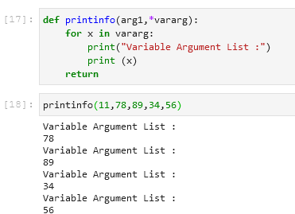
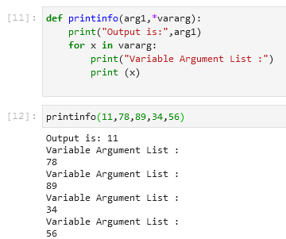
User Defined Functions
Without printing arg1
Without return statement
Works fine

Slide 9
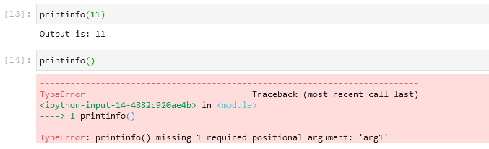
User Defined Functions
Works perfectly, if Variable Parameters are NIL
But needs compulsory Parameter, else raises error

Slide 10
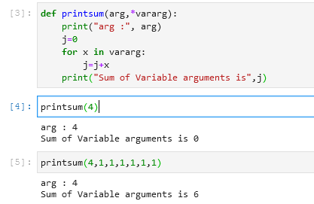
User Defined Functions
Function that calculates sum of Variable length parameters

Slide 11
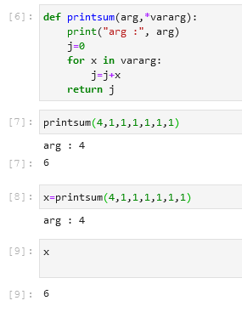
User Defined Functions
Using Return statement in the function
Value 6 gets printed on executing the function
Storing the Value returned in some variable x
Printing the value of that Variable

Slide 12
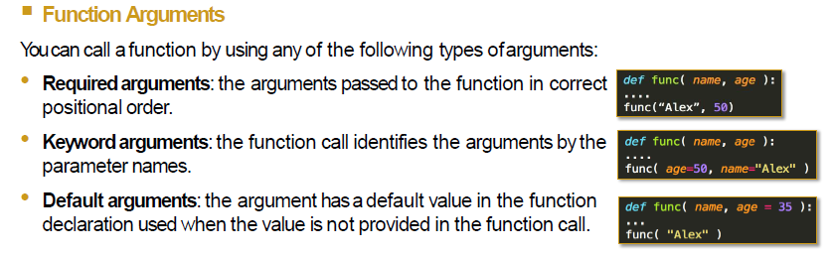
User Defined Functions

Slide 13
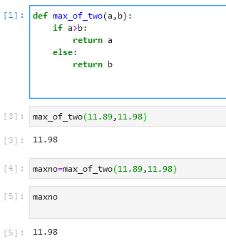
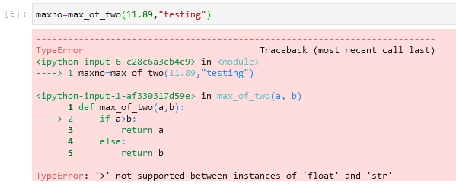
User Defined Functions
Function to find max of 2 nos with return statement
Return value stored in variable
Error on Passing Strings as a parameter

Slide 14
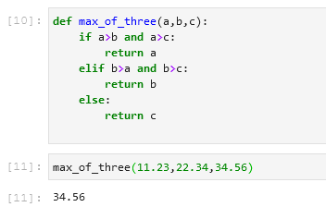
User Defined Functions
Function to fins max of 3 nos with return statement

Slide 15
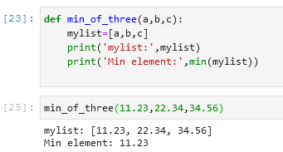
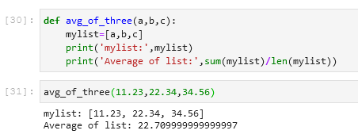
User Defined Functions
Minimum of 3 nos using List
Average of 3 nos using List

Slide 16

Recursion: function calling itself
def factorial(n):
if n==0:
return 1
else:
return n*factorial(n-1)
num = int(input("Enter a number: "))
print("The factorial of a {0} is: ".format(num), factorial(num))
Output:

Slide 17
Lambda Function

Slide 18
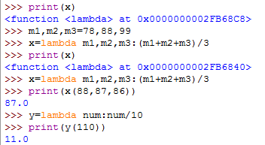
Lambda Function
A lambda function is a small anonymous function.
A lambda function can take any number of arguments, but can only have one expression.
Syntax
lambda arguments : expression
The expression is executed and the result is returned:
Example
Add 10 to argument a, and return the result:
x = lambda a : a + 10 print(x(5))

Slide 19
Lambda Function
Lambda functions can take any number of arguments:
Example
Multiply argument a with argument b and return the result:
x = lambda a, b : a * b print(x(5, 6))
Example
Summarize argument a, b, and c and return the result:
x = lambda a, b, c : a + b + c print(x(5, 6, 2))

Slide 20
Why Use Lambda Functions?
The power of lambda is better shown when you use them as an anonymous function inside another function.
Say you have a function definition that takes one argument, and that argument will be multiplied with an unknown number:
def myfunc(n): return lambda a : a * n

Slide 21
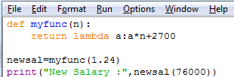

Use that function definition to make a function that always doubles the number you send in:
Example
def myfunc(n): return lambda a : a * n mydoubler = myfunc(2) print(mydoubler(11))

Slide 22
Or, use the same function definition to make a function that always triples the number you send in:
Example
def myfunc(n): return lambda a : a * n mytripler = myfunc(3) print(mytripler(11))

Slide 23
Example
HRA=24% of Basic or a
Ta=2700 Rs

Slide 24
Or, use the same function definition to make both functions, in the same program:
Example
def myfunc(n): return lambda a : a * n mydoubler = myfunc(2) mytripler = myfunc(3) print(mydoubler(11)) print(mytripler(11))
Use lambda functions when an anonymous function is required for a short period of time.

Slide 25
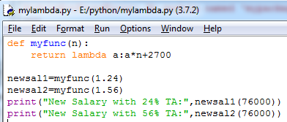

Or, use the same function definition to make both functions, in the same program:
Example
HRA=24% of Basic or a Ta=2700 Rs
HRA=56% of Basic or a Ta=2700 Rs

Slide 26
Python filter() Function
Python filter() function is used to get filtered elements. This function takes two arguments, first is a function and the second is iterable. The filter function returns a sequence from those elements of iterable for which function returns True.
The first argument can be None if the function is not available and returns only elements that are True.
Syntax:
filter (function, iterable)
Parameters:
function: It is a function. If set to None returns only elements that are True.
Iterable: Any iterable sequence like list, tuple, and string.

Slide 27
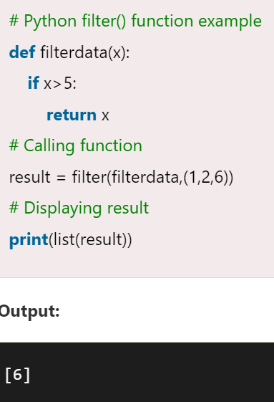
Example filter()

Slide 28
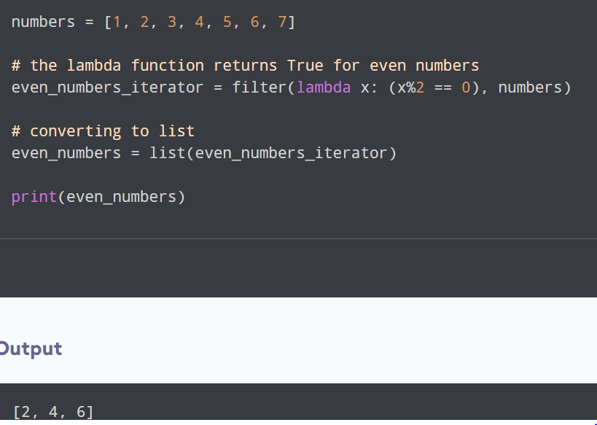
Use filter() with lambda

Slide 29
Map() function
The python map() function is used to return a list of results after applying a given function to each item of an iterable(list, tuple etc.)
Syntax:
map(function, iterables)
Parameters:
function- It is a function in which a map passes each item of the iterable.
iterables- It is a sequence, collection or an iterator object which is to be mapped

Slide 30
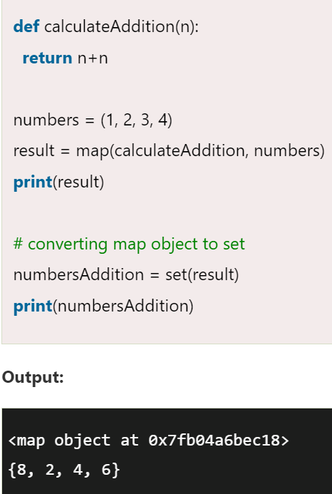
Example

Slide 31
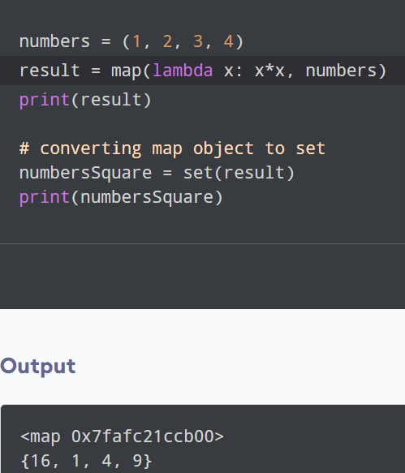
Use lambda function with map() function

Slide 32
Range() function
Python range() function returns an immutable sequence of numbers starting from 0, increments by 1 and ends at a specified number.
Syntax:
range(start, stop, step)
Parameters:
start (optional) : It is an integer number that specifies the starting position. The Default value is 0.
stop (optional) : It is an integer that specifies the ending position.
step (optional) : It is an integer that specifies the increment of a number. The Default value is 1.

Slide 33
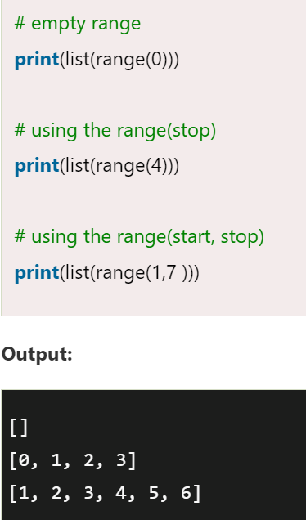
Example

